Slide 1
Veterinary Database Project
Presented by Sequoia Andrade

Slide 2
Overview
Database Requirements
ER Diagram
Schemas
Demo
Queries
UI

Slide 3
Database Requirements
Stores data for a veterinary clinic:
Pet IDs, names, age, gender, weight, species, breed
Owner IDs, names, contact info
Vet IDs, names, contact info, and medical license
Vaccine IDs and types
Appointment IDs, dates, times, and exam rooms
Each pet must have exactly one owner, and each owner must have at least one pet.
Each appointment is with exactly one pet, and each appointment is administered by only one vet.

Slide 4

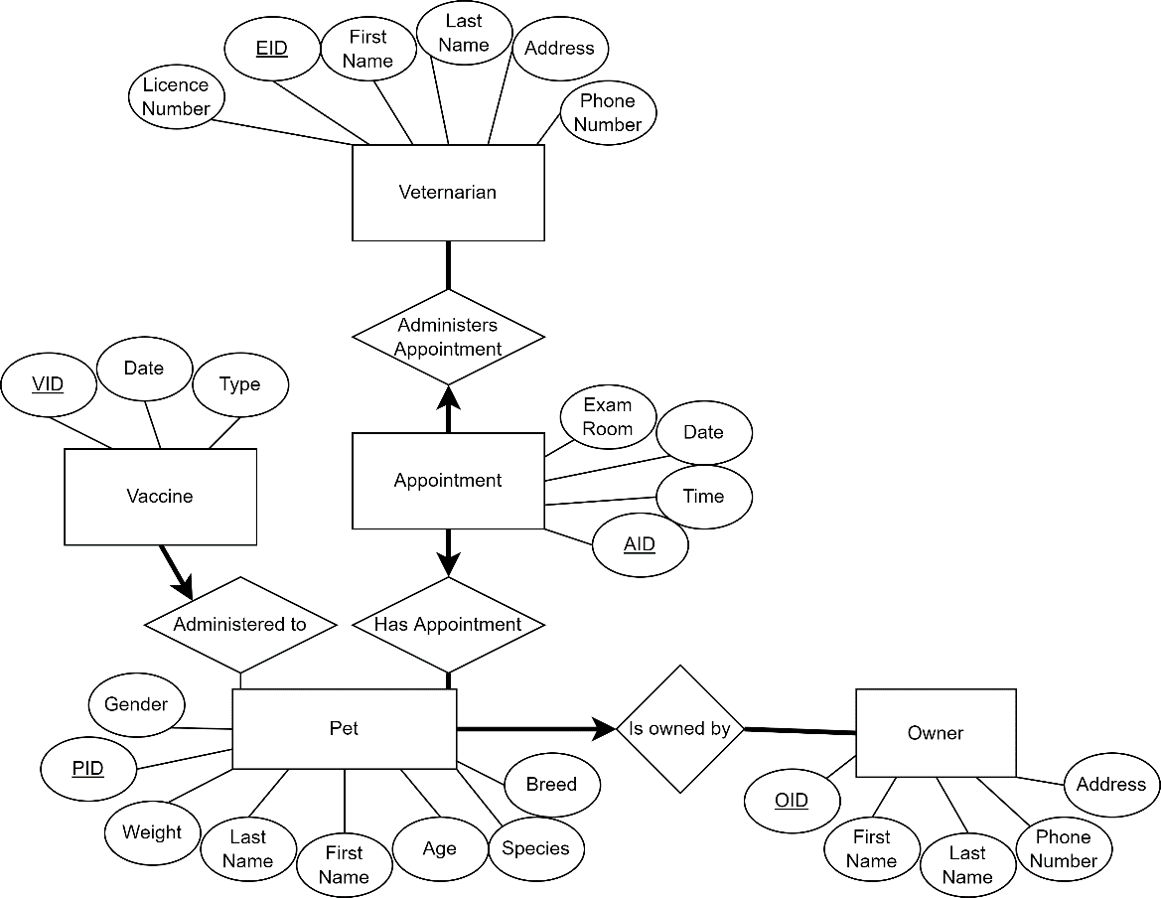
Entity-Relation Diagram

Slide 5
Schemas
Pets(PID: varchar(10), first_name: varchar(20), last_name: varchar(20), gender: varchar(6), weight: float, age: integer, species: varchar(20), breed: varchar(20))
Vets(EID : varchar(10), first_name: varchar(20), last_name: varchar(20), address: varchar(20), phone_number: char(10), license_number: char(10))
Owners(OID: varchar(10), first_name: varchar(20), last_name: varchar(20), address: string, phone_number: char(10))
Appointments(AID: varchar(15), exam_room: integer, appt_date: date, appt_time: time)
Vaccines(VID: varchar(15), vax_type: varchar(20))
Vet_appointments(EID: varchar(10), AID: varchar(15))
Pet_appointments(PID: varchar(10), AID: varchar(15))
Pet_vaccines(VID: varchar(15), PID: varchar(10), vax_date: date)
Pet_owners(PID: varchar(10), OID:varchar(10))

Slide 6
Demo
View: show all the current pets and their owners in the system
SELECT * FROM current_owners_pets;

Slide 7
Demo
Query 1: Find the name of all owners with more than 1 cat.
SELECT O.first_name, O.last_name FROM Owners O, Pets P, Pet_Owners PO
WHERE (PO.OID = O.OID) AND (PO.PID = P.PID) AND (P.species = ‘cat’)
GROUP BY O.OID HAVING count(*)>1;
Query 2: Find the owner and vet names of owners whose pets have only had appointments with one vet.
SELECT O.first_name, O.last_name, V.first_name, V.last_name from Owners O, Vets V, Pets P, Vet_Appointments VA, Pet_Appointments PA, Pet_Owners PO
WHERE (PO.OID = O.OID) AND (PO.PID = P.PID) AND (PA.PID=P.PID) AND (VA.EID = V.EID) AND (VA.AID = PA.AID)
GROUP BY O.OID HAVING count(V.EID=1);

Slide 8
Demo
Query 3: Find the maximum age and species of the oldest pet
SELECT P.species, P.age FROM Pets P
WHERE P.age>=all (SELECT P2.age FROM Pets P2);
Query 4: Find all pets with no vaccines
SELECT * FROM Pets P
WHERE P.PID NOT IN (SELECT PV.PID FROM Pet_Vaccines PV);

Slide 9
Demo
Graphic User Interface:
Data viewing
Data Entry
Ex:
Add new pet
Add new appointment
View changes

Slide 10
Thank you

